Slide 1
Hmmmm…..
Talk to your group about ways you can think that something can move in one direction by exerting a force in the opposite direction.
What did you come up with?

Slide 2
Newton’s Third Law
Forces always act in pairs!
Newton’s Third Law: For every action, there is an equal and opposite reaction.
Every time one object exerts a force on another object, the second object exerts a force that is equal in size and opposite in direction back on the first object.

Slide 3
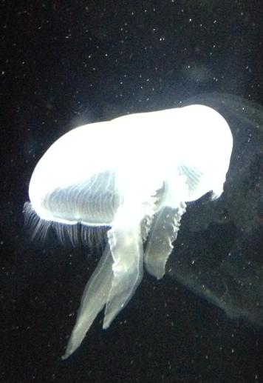
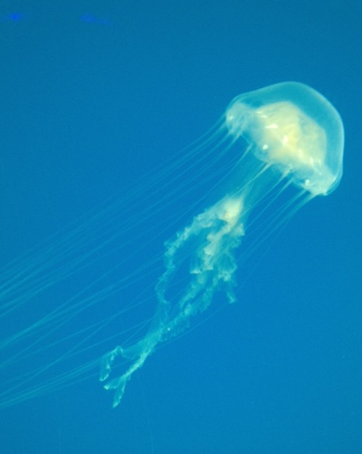
Newton’s Third Law Illustrated!
By squeezing water out of its umbrella-like body, the jellyfish applies a force in one direction to move in the opposite direction.

Slide 4
Action/Reaction Force Pairs
The force that is exerted on an object and the force that the object exerts back are known together as an action/reaction force pair.
Ex: the jellyfish pushing on the water is the action force, the water pushing back on it is the reaction force.
Action/Reaction force pairs do not always result in motion. For example, if you press down on a table, the table resists the push with the same amount of force even though nothing happens.

Slide 5
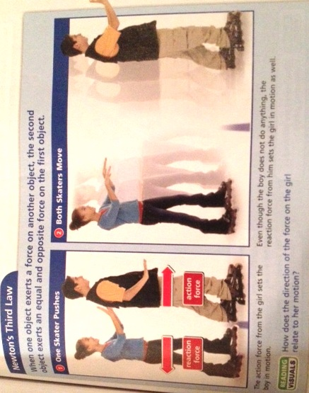

Slide 6
Action/Reaction vs. Balanced/Unbalanced
Don’t let action/reaction pairs get confused with balanced/unbalanced forces!
Balanced/Unbalanced Forces: If you and a friend pull on a backpack with the same force, the backpack doesn’t move because the forces are balanced. These forces are exerted on ONE object.
Action/Reaction: As you drag a heavy backpack across the floor, you can feel the backpack pulling on you with an equal amount of force. The action force and reaction force are acting on TWO things- one on the backpack, one on you.

Slide 7
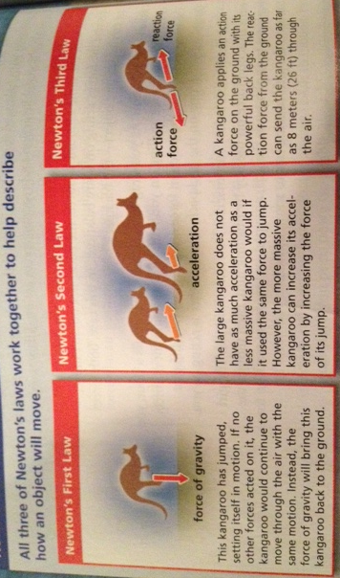
A Summary of Newton’s Laws

Slide 8
Momentum
MOMENTUM = a measure of mass in motion; the product of its mass and its velocity.
Example: If you throw a tennis ball and a wrecking ball at the same brick wall with the same velocity, the tennis ball will bounce back but the wrecking ball would likely destroy the brick wall. This is because the wrecking ball has more mass. You can’t change their masses, but you could increase the momentum of either ball by increasing the velocity.

Slide 9
Momentum
Momentum is similar to inertia, in that it depends on an object’s mass. BUT, unlike inertia, momentum takes velocity into account.
Example: A wrecking ball moving slowly has less momentum than a wrecking ball that is moving fast.
With less momentum, the slower wrecking ball won’t do as much damage as the faster one.

