Slide 1
Demonstration
I’m going to drop a ping pong ball and a golf ball from the same height at the same time.
Which one is going to hit the desk first? What do you think?
What did you observe?
Notes:
Both balls hit the desk at the same time – gravity accelerates all masses equally

Slide 2
Falling Objects
Two objects with different masses fall at the same rate.
This is because the object with greater mass has more gravity exerted on it, but greater mass means more inertia so the greater force doesn’t produce a larger acceleration.

Slide 3
Force, Mass, and Acceleration
If you want to give two objects with different masses the same acceleration, you have to apply different forces to them.
Ex: Sliding an empty water bottle across the table requires less force than sliding a full water bottle across the table.

Slide 4
Newton’s Second Law
Acceleration of an object increases with increased force and decreases with increased mass.
The direction in which an object accelerates is the same as the direction of the force.
Simply put: Newton’s Second Law is…
F = ma
(Force = mass x acceleration)

Slide 5
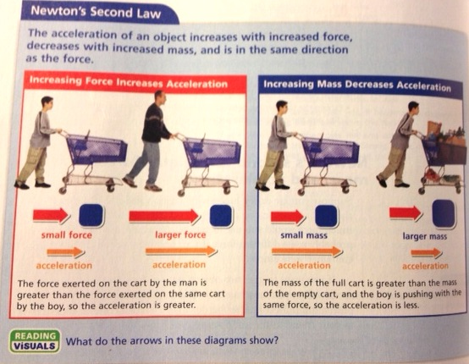

Slide 6
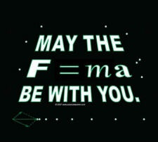

Slide 7
Calculating Force
The standard unit of force is the newton (N).
Because force = mass x acceleration, force is measured in units of mass (kg) times units of acceleration (m/s²).
A newton is the amount of force that it takes to accelerate 1 kg of mass 1 m/s².
So…. I N = 1 kg x 1 m/s².

Slide 8
Earth’s Gravitational Pull
The Earth’s gravity exerts a downward pull downward pull on a dropped coin.
The coin exerts an equal upward force on earth.
Because the coin has such a small mass compared to Earth, the coin can easily be accelerated.
This acceleration due to the Earth’s gravity is called “g” and is equal to 9.8 m/s² at Earth’s surface.
You calculate this using F = ma, where a = g, so the formula for calculating force due to gravity on Earth is F = mg
Notes:
Which of Newton’s laws does the first two points apply to? Newton’s third law
What about g’s? second

Slide 9
Sample Problem
What force is needed to accelerate a 10 kg shopping cart 3 m/s²?
Remember KQS!
What do we know? 10 kg moves 3 m/s²
Question? Force?
Solve! F = ma F = 10 kg x 3 m/s²
F= 30 kg x m/s²
Since 1 kg x 1 m/s² = 1 N,
F = 30 N

Slide 10
Practice Problems
If a 5 kg ball is accelerating 1.2 m/s², what is the force on it?
A person on a scooter is accelerating 2 m/s². If the person has a mass of 50 kg, how much force is acting on that person?
Notes:
6 N
100 N

Slide 11
Forces can change the direction of motion
Generally we think force either speeds up or slows down the motion of an object, but it can also make it change directions.
If you apply a force to an object, the direction the object accelerates is the same as the direction of the force. This can allow an object to change direction without changing speed.
Ex: A soccer player can control the motion of a soccer ball by applying force that changes the ball’s direction but not its speed.

Slide 12
Centripetal Force
CENTRIPETAL FORCE = any force that keeps an object moving in a circle.
Without this force, the object would go flying off into a straight line.
Think of a ball tied to a string. As you whirl it in a circle, the force of the string changes the ball’s direction of motion. The centripetal force on the ball is the pull from the string.
You have to pull harder on the string when you whirl the ball faster because it takes more centripetal force to keep the ball moving at the greater speed.

Slide 13
Newton’s 2nd Law and Centripetal Force
Greater acceleration requires greater centripetal force.
A more massive object requires a greater centripetal force to have the same circular speed as a less massive object.
No matter what the mass of an object is, if it moves in a circle, its force and acceleration are directed toward the center of the circle.

