Slide 1
Mechanical Advantage
Simple Machines

Slide 2
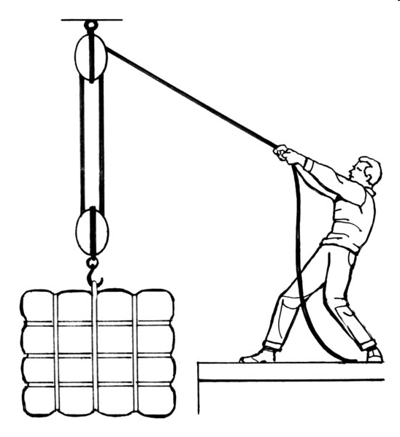
What is a machine?
Machines make work easier by:
Changing the amount of force you exert
Changing the distance over which you exert the force
Changing the direction the force is exerted

Slide 3
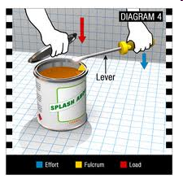
Which is easier?
Opening a paint can with your fingers?
Opening a paint can with a screwdriver?
OR
The force is multiplied and redirected.

Slide 4
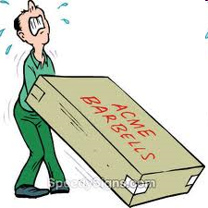
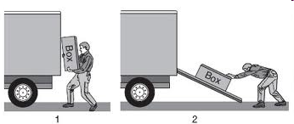
Which is easier?
Pushing a heavy box up a ramp into a truck?
Lifting a heavy box into a truck?
OR
The force is both multiplied and redirected.

Slide 5
Mechanical Advantage
Mechanical Advantage is how much more force you can get out of a simple machine. The main advantage of using a simple machine is to multiply your force so you can do more work with less effort
Two Types of Work:
Work input is the amount of work done on a machine.
Work output is the amount of work done by a machine.

Slide 6
Calculating Mechanical Advantage
Remember….
Input is what the MACHINE does
Output is what YOU do
Formula: Mechanical Advantage = output force
input force
For example: if you put in 10 Newtons of force into a machine and it puts out 80 Newtons of work your mechanical advantage: 80 = 8
10

Slide 7
Mechanical Advantage:What does it mean?
Mechanical Advantage = 1
There is no advantage to using the machine
Mechanical Advantage > 1
The machine makes work easier
Mechanical Advantage < 1
The machine makes work harder

