Slide 1
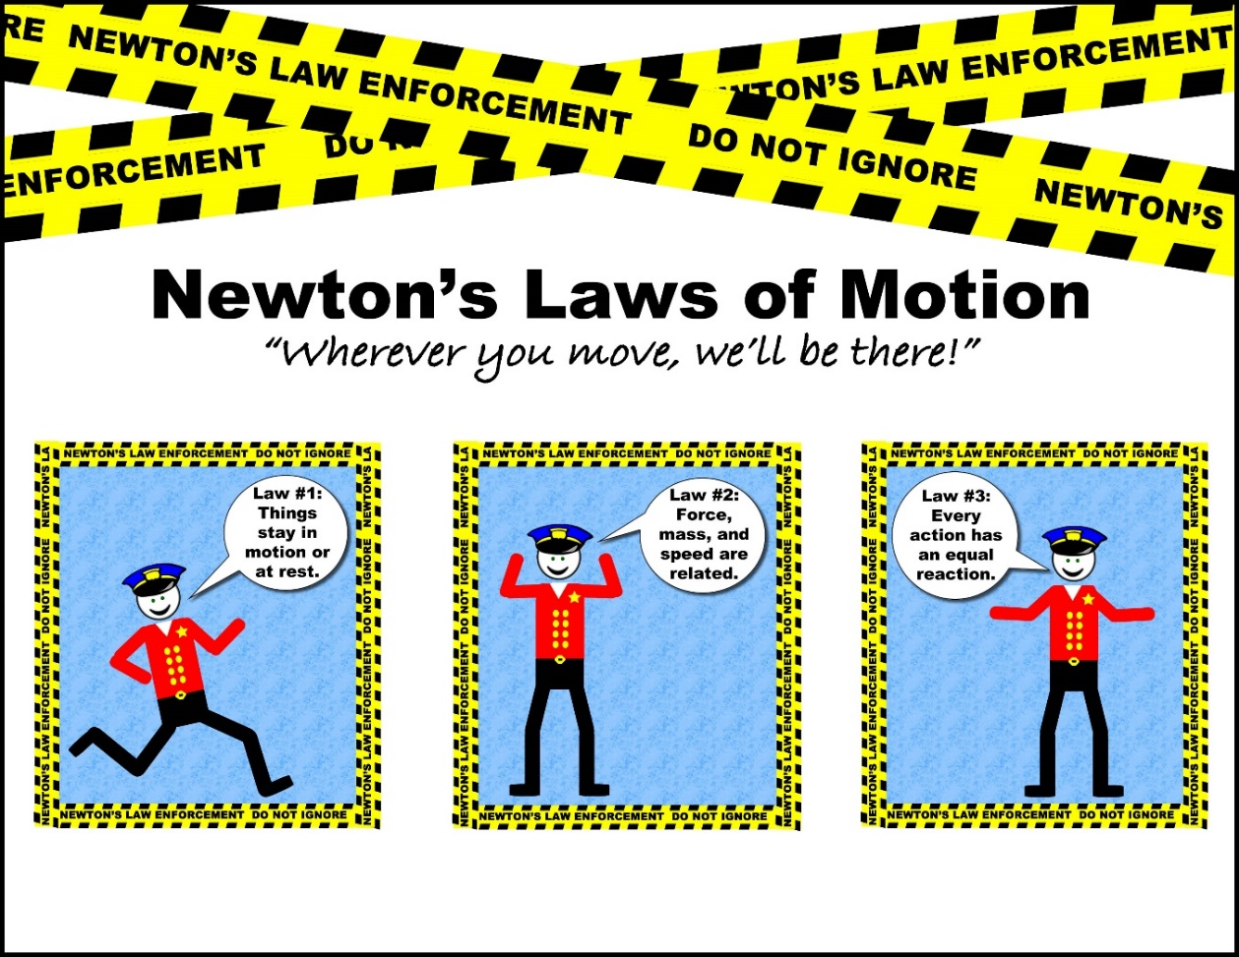
Forces/Introduction to Newton’s 3 Laws of Motion

Slide 2
How do you change an object’s motion?
Choose an object from your desk. Change its motion in several ways:
Not moving to moving
Moving to not moving
Moving to moving faster
Moving to moving in a different direction
Describe the actions you used to change the motion.
Notes:
Show Brainpop- Force after this slide

Slide 3
FORCE
Force = a push or pull
Anytime you change the motion of an object, you use force.
Example: a pitcher throws a ball, the batter hits it, and a fan in the stands catches it. Each of these people uses force. The pitcher sets the ball in motion, the batter changes the direction of the ball’s motion, and the fan stops the ball’s motion.

Slide 4
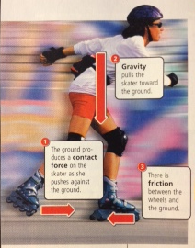
Types of Force
Contact Force
Gravity
Friction

Slide 5
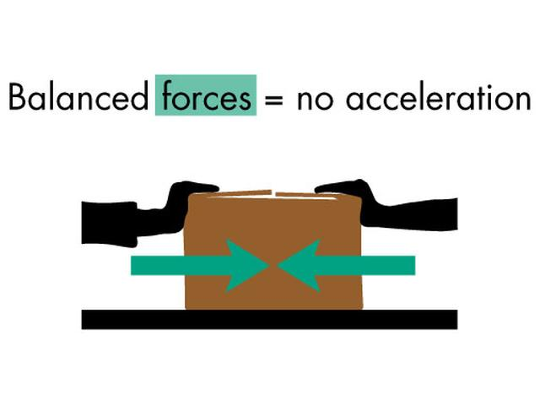
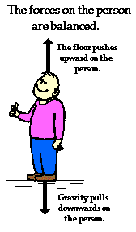
Balanced Forces
Equal forces acting on one object in opposite directions
Does not change the motion of an object (net force is 0)

Slide 6
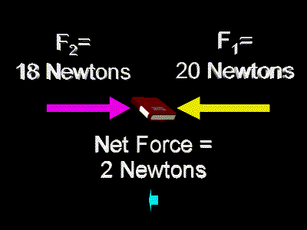
Unbalanced Forces
Changes the motion of an object. It will speed up, slow down of change direction (acceleration)
Net force, the overall force acting on an object when all the forces are combined, will be greater or less than 0

Slide 7
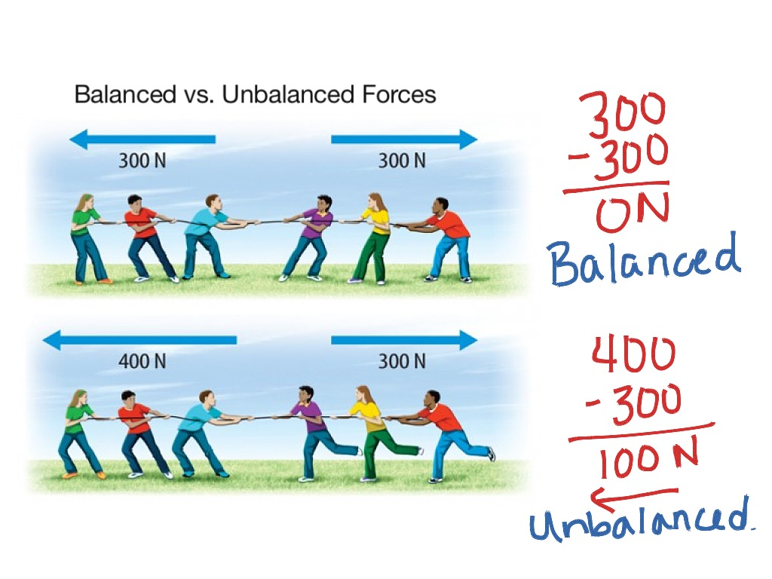
Balanced vs Unbalanced Forces
Which photograph shows a net force of zero?

Slide 8
Demonstration
I have a paper clip tied to one end of a long string, and three paperclips attached to the other end.
I will hold the single paper clip in the middle of my lab desk and let the other end hang over the edge.
What happens as I let go of the paper clip?
What happens after I add a fourth paper clip?
What is the relationship between the number of hanging paper clips and the motion of the paper clip on the table?
Notes:
The more paper clips on the other end of the string, the faster the motion of the paper clip on the table.

Slide 9
Gravity
GRAVITY = the force between two objects.
As an object falls to the ground, it accelerates, moving faster and faster.
The strength of the gravitational force between two objects depends on two factors:
Mass- the more mass, the greater the gravity that is exerted on the other object
If the mass of an object is doubled, the force between the two objects is doubled
Distance- as distance increases, gravity decreases
If the distance is doubled, the gravity is one-fourth as strong as before
Notes:
Gravity is not just between the Earth and other objects. There is also a pull between the Sun and the moon for example. The force of gravity between dust and gas particles in space helped form the solar system.

Slide 10
Weight vs Mass
Weight and mass aren’t the same things!
Mass = how much matter something contains
Weight = force of gravity on an object
Weight can change based on location (on the Earth, on the moon, in space, etc)
Notes:
If you were to ride down on an elevator and step on a scale you would weigh less but you would still have the same mass

Slide 11
Friction
FRICTION = force that resists the motion between two surfaces in contact.
Friction between two surfaces depends on:
The material. Certain materials cause more friction (carpet, gravel, and sand) compared to surfaces such as ice and hardwood floors.
Motion. It’s easier to apply force to an object once it’s in motion than to apply force when it is stopped. MORE MOTION = LESS FRICTION
Pressure. The harder two surfaces are pushed together, the more difficult it is for them to slide over each other. MORE PRESSURE = MORE FRICTION

Slide 12
Friction and Heat
Friction between surfaces produces heat.
The greater the friction the greater the heat
This is because the molecules are speeding up. The faster they move, the temperature increases.
This can be intense- you can rub two sticks together and start a fire if you rub them fast enough. If there isn’t oil to lubricate (reduce friction) parts of your car, it can overheat and stop working.

Slide 13
Air Resistance
Air Resistance = the friction due to air
Air resistance depends on surface area and the speed of an object:
An object with larger SA comes into contact with more molecules as it moves than an object with smaller SA. INCREASED SA = INCREASED AIR RESISTANCE
The faster an object moves through the air, the more molecules it comes into contact with in a given amount of time. INCREASED SPEED = INCREASED AIR RESISTANCE

